Slide 1

Module2
BUILD INTERFCAES USING BOOTSTARP (08) Introduction to web design from an evolutionary perspective, user interface design through bootstrap, containers, tables, jumptrons, list, cards, carousal, navigation, modals, flex and forms, responsive web page design, basic UI grid structure.

Slide 2
Bootstrap
Bootstrap Tutorial:
1) Bootstrap is the most popular HTML, CSS and JavaScript framework for developing a responsive and mobile friendly website.
2) It is absolutely free to download and use.
3) It is a front-end framework used for easier and faster web development.
4) It includes HTML and CSS based design templates for forms, buttons, tables, navigation,
image carousels and many others.
5) It is compatible on most of browsers like Chrome, Firefox, Internet Explorer, Safari
and Opera etc.
6) A website is called responsive website which can automatically adjust itself to look
good on all devices, from smart phones to desktops etc.
Where to Get Bootstrap 4:
There are two ways to start using Bootstrap 4 on your own web site. You can:
*) Include Bootstrap 4 from a CDN (Content Delivery Network)
*) Download Bootstrap 4 from getbootstrap.com

Slide 3
Bootstrap
Include Bootstrap 4 from a CDN (Content Delivery Network)
Include these 4 links in head tag
<link rel="stylesheet" href="https://cdn.jsdelivr.net/npm/bootstrap@4.0.0/dist/css/bootstrap.min.css" integrity="sha384-Gn5384xqQ1aoWXA+058RXPxPg6fy4IWvTNh0E263XmFcJlSAwiGgFAW/dAiS6JXm" crossorigin="anonymous">
<script src="https://cdn.jsdelivr.net/npm/bootstrap@4.0.0/dist/js/bootstrap.min.js" integrity="sha384-JZR6Spejh4U02d8jOt6vLEHfe/JQGiRRSQQxSfFWpi1MquVdAyjUar5+76PVCmYl" crossorigin="anonymous"></script>
<script src="https://code.jquery.com/jquery-3.2.1.slim.min.js" integrity="sha384-KJ3o2DKtIkvYIK3UENzmM7KCkRr/rE9/Qpg6aAZGJwFDMVNA/GpGFF93hXpG5KkN" crossorigin="anonymous"></script>
<script src="https://cdn.jsdelivr.net/npm/popper.js@1.12.9/dist/umd/popper.min.js" integrity="sha384-ApNbgh9B+Y1QKtv3Rn7W3mgPxhU9K/ScQsAP7hUibX39j7fakFPskvXusvfa0b4Q" crossorigin="anonymous"></script>

Slide 4
Bootstrap
<!DOCTYPE html>
<html lang="en">
<head>
<meta charset="UTF-8">
<meta name="viewport" content="width=device-width, initial-scale=1.0">
<title>Document</title>
<link rel="stylesheet" href="C:\\Users\\ALEKHYA\\Desktop\\wad\\bootstrap\\css\\bootstrap.css">
<script src="C:\\Users\\ALEKHYA\\Desktop\\wad\\bootstrap\\js\\bootstrap.js"></script>
<script src="C:\\Users\\ALEKHYA\\Desktop\\wad\\bootstrap\\js\\jquery.js"></script>
</head>

Slide 5
Bootstrap
<body>
<div>
<h1>My First Bootstrap Page</h1>
<p>This part is inside a .container class.</p>
<p>The .container class provides a responsive fixed width container.</p>
<p>Resize the browser window to see that its width (max-width) will change at different breakpoints.</p>
</div>
</body>

Slide 6
Bootstrap
<body>
<h1>bootsrap tutorials</h1>
<P>Bootstrap is the most popular HTML, CSS, and JavaScript framework for developing responsive, mobile-first websites.
Bootstrap is completely free to download and use!
</P>
</body>
</html>

Slide 7
containers
Containers are the most basic layout element in Bootstrap and are required when using our default grid system. Containers are used to contain, pad, and (sometimes) center the content within them. While containers can be nested, most layouts do not require a nested container.
There are two container classes in bootstrap:
.container
.container-fluid
container: The .container class provides a responsive fixed width container. In the below example, the div with class “container” will have a fixed left and right margin and will not take the complete width of its parent or the viewport.

Slide 8
containers
<!DOCTYPE html>
<html lang="en">
<head>
<meta charset="UTF-8">
<meta name="viewport" content="width=device-width, initial-scale=1.0">
<title>Document</title>
<link rel="stylesheet" href="C:\\Users\\ALEKHYA\\Desktop\\wad\\bootstrap\\css\\bootstrap.css">
<script src="C:\\Users\\ALEKHYA\\Desktop\\wad\\bootstrap\\js\\bootstrap.js"></script>
<script src="C:\\Users\\ALEKHYA\\Desktop\\wad\\bootstrap\\js\\jquery.js"></script>
</head>

Slide 9
containers
<body>
<div class="container">
<h1>My First Bootstrap Page</h1>
<p>This part is inside a .container class.</p>
<p>The .container class provides a responsive fixed width container.</p>
<p>Resize the browser window to see that its width (max-width) will change at different breakpoints.</p>
</div>

Slide 10
containers
container-fluid: The .container-fluid class provides a full-width container which spans the entire width of the viewport. In the below example, the div with class “container-fluid” will take up the complete width of the viewport and will expand or shrink whenever the viewport is resized.
<!DOCTYPE html>
<html lang="en">
<head>
<meta charset="UTF-8">
<meta name="viewport" content="width=device-width, initial-scale=1.0">
<title>Document</title>
<link rel="stylesheet" href="C:\\Users\\ALEKHYA\\Desktop\\wad\\bootstrap\\css\\bootstrap.css">

Slide 11
containers
<script src="C:\\Users\\ALEKHYA\\Desktop\\wad\\bootstrap\\js\\bootstrap.js"></script>
<script src="C:\\Users\\ALEKHYA\\Desktop\\wad\\bootstrap\\js\\jquery.js"></script>
</head>
<body>
<div class="container-fluid">
<h1>My First Bootstrap Page</h1>
<p>This part is inside a .container-fluid class.</p>
<p>The .container-fluid class provides a full width container, spanning the entire width of the viewport.</p>
</div> </body>

Slide 12
containers
Container Padding
By default, containers have 15px left and right padding, with no top or bottom padding. Therefore, we often use spacing utilities, such as extra padding and margins to make them look even better. For example, .pt-3 means "add a top padding of 16px":
example
<div class="container pt-3">
<h1>My First Bootstrap Page</h1>
<p>This container has a top padding of 16 pixels (.pt-3).</p>
<p>Try to remove the .pt-3 class to see the difference.</p>
</div>

Slide 13
containers
Container Border and Color
Other utilities, such as borders and colors, are also often used together with containers: p-3 represents padding top and bottom
My-3 represents margin top and bottom
example
<div class="container p-3 my-3 border">
<h1>My First Bootstrap Page</h1>
<p>This container has a border and some extra padding and margins.</p>
</div>
<div class="container p-3 my-3 bg-dark text-white">
<h1>My First Bootstrap Page</h1>
<p>This container has a dark background color and a white text, and some extra padding and margins.</p>
</div>

Slide 14
Grid system
1) Bootstrap's grid system allows up to 12 columns across the page.
2) If you do not want to use all 12 columns individually, you can group the columns
together to create wider columns.
3) Bootstrap's grid system is responsive, and the columns will re-arrange
automatically depending on the screen size.
4) The Bootstrap 4 grid system has five classes:
*) col- (extra small devices - screen width less than 576px)
*) col-sm- (small devices screen width equal to or greater than 576px)
*) col-md- (medium devices - screen width equal to or greater than 768px)
*) col-lg- (large devices - screen width equal to or greater than 992px)
*) col-xl- (xlarge devices - screen width equal to or greater than 1200px)
The classes above can be combined to create more dynamic and flexible layouts. Make
sure that the sum adds up to 12 or fewer (it is not required that you use all 12
available columns).

Slide 15
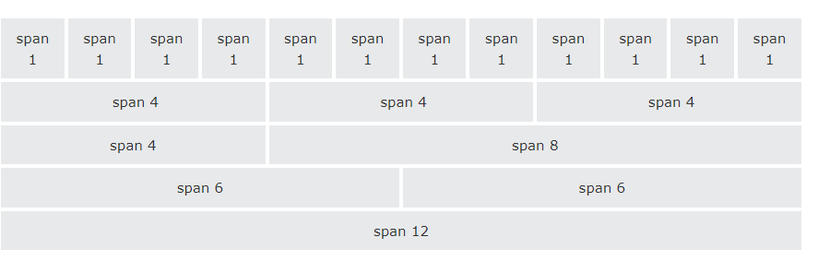
Grid system

Slide 16
Grid system
Basic Structure of a Bootstrap Grid:
<div class="row">
<div class="col-*-*"></div>
</div>
<div class="row">
<div class="col-*-*"></div>
<div class="col-*-*"></div>
<div class="col-*-*"></div>
</div>
<div class="row">
...
</div>
Follow the below instructions while creating a Bootstrap Grid:
Create a row (<div class="row">).
Add the number of columns, you want in the grid (tags with appropriate .col-*-* classes).
Note that numbers in .col-*-* should always add up to 12 for each row.

Slide 17
Grid system
example1
<div class="container-fluid">
<h2>Three equal-width columns</h2>
<div class="row">
<div class="col" style="background-color:lavender;">.col</div>
<div class="col" style="background-color:orange;">.col</div>
<div class="col" style="background-color:lavender;">.col</div>

Slide 18
Grid system
example2
<body style="color:red;background-color:powderblue" >
<div class="container-fluid">
<div class="row">
<div class="col-md-3" style="border: 2px solid green;">
<h1 style=color:blue> Subash chandra bose</h1>
<p>Subhas Chandra Bose was an Indian nationalist whose defiance of British authority in India made him a hero among many Indians, but his wartime alliances with Nazi Germany and Imperial Japan left a legacy vexed by authoritarianism, anti-Semitism, and military failure.</p>
</div>
<div class="col-md-3" style="border: 2px solid gold;">
<h1 style=color:green> Mahatma Gandhi</h1>
<p>Mohandas Karamchand Gandhi was an Indian lawyer, anti-colonial nationalist and political ethicist who employed nonviolent resistance to lead the successful campaign for India's independence from British rule. He inspired movements for civil rights and freedom across the world</p>
</div>

Slide 19
Grid system
<div class="col-md-3" style="border: 2px solid gray">
<h1 style=color:green> Bhagat singh</h1>
<p>Bhagat Singh was a charismatic Indian revolutionary who participated in the mistaken murder of a junior British police officer in what was to be retaliation for the death of an Indian nationalist</p>
</div>
<div class="col-md-3" style="border: 2px solid orangered;">
<h1 style=color:blue> lala lajapathi Rai</h1>
<p>Lajpat Rai was an Indian freedom fighter, politician, and author, generally known as Lala Lajpat Rai. He was popularly known as Punjab Kesari, and also as 'Punjab da Sher' which literally means the 'Lion of Punjab'. He was one of the three members of the Lal Bal Pal trio</p>
</div>
</div>
<body>

Slide 20
Grid system
example3
<body>
<div class="container-fluid">
<div class="row">
<div class="col-sm-12 col-md-6 col-lg-4 col-xl-3 bg-success text-white" >col</div>
<div class=" col-sm-12 col-md-6 col-lg-4 col-xl-3 bg-dark text-white" >col</div>
<div class=" col-sm-12 col-md-6 col-lg-4 col-xl-3 bg-danger text-white" >col</div>
<div class=" col-sm-12 col-md-6 col-lg-4 col-xl-3 bg-success text-white" >col</div>
<div class=" col-sm-12 col-md-6 col-lg-4 col-xl-3 bg-primary text-white" >col</div>
<div class=" col-sm-12 col-md-6 col-lg-4 col-xl-3 bg-secondary text-white" >col</div> </div></div>
</body>

Slide 21
Typography
Bootstrap Typography:
Styling and Formatting of text content.
1) Display Headings: Bootstrap 4 introduces display headings that can be
used when you need a heading to stand out. Display headings are displayed
in larger font-size but lighter font-weight.
2) Paragraphs: You can make a paragraph stand out by adding the class lead
on it. You can easily align text left, right, and center inside a
paragraph using the text alignment classes. You can also align text based
on screen size using the responsive text alignment classes.
3) Text Formatting: You are free to use text formatting tags like <strong>,
<i>, <small> to make your text bold, italic, small and so on, in the same
way you do in simple HTML.
4) Text Transformation: You can also transform the text to lowercase,
uppercase or make them capitalize.

Slide 22
Typography
5) Text Coloring: Colors are the powerful method of conveying important
information in website design. Bootstrap has handful of emphasis utility
classes that can be used for this purpose such as showing success message
in green color, warning or error message in red color, etc.
6)Styling Blockquotes: You can also give pretty look to your blockquotes
7)Bootstrap 4 will style the HTML <abbr> element with as dotted border
bottom
8)Bootstrap 4 will style the HTML <dl> element
9)Bootstrap 4 will style the HTML <kbd> element
10) Bootstrap 4 will style the HTML <list> element

Slide 23
Typography
Example for display headings
<body>
<h1 class="display-1">hi hello </h1>
<h1 class="display-2">hi hello</h1>
<h1 class="display-3">hi hello</h1>
<h1 class="display-4">hi hello</h1>
<h1>hi hello </h1>
</body>
Code tag example
<div class="container">
<code>
class ale<br>
{
public static void main(String args[])<br>
{
System.out.println("hello");
}
}
</code>
</div>

Slide 24
Typography
Example for paragraph formatting
<body>
<div class="container">
<p class="lead">
Baahubali: The Beginning is a 2015 Indian Telugu epic action film co-written and directed by S. S. Rajamouli, and produced by Shobu Yarlagadda and Prasad Devineni under Arka Media Works. The film was produced in Tollywood, the centre of Telugu language films in India,[b] and was filmed in both Telugu and Tamil languages simultaneously.
</p >
<p class="text-center"> It features Prabhas in a dual role alongside Rana Daggubati, Anushka Shetty, Tamannaah, Ramya Krishna, Sathyaraj, and Nassar. The first of two cinematic parts, the film follows Sivudu, an adventurous young man who helps his love Avantika rescue Devasena, the former queen of Mahishmati who is now a prisoner under the tyrannical rule of king Bhallaladeva. The story concludes in Baahubali 2: The Conclusion.</p>
</div>
</body>

Slide 25
Typography
example for paragraph alignment depending on device
<p class="text-lg-justify"> It features Prabhas in a dual role alongside Rana Daggubati, Anushka Shetty, Tamannaah, Ramya Krishna, Sathyaraj, and Nassar. The first of two cinematic parts, the film follows Sivudu, an adventurous young man who helps his love Avantika rescue Devasena, the former queen of Mahishmati who is now a prisoner under the tyrannical rule of king Bhallaladeva. The story concludes in Baahubali 2: The Conclusion.</p>
Text transformation example
<p class="text-uppercase">hello students how r u</p>

Slide 26
Typography
Text colors and background color classes example
<div class="container">
<p class="text-primary bg-info" >hello students how r u</p>
<p class="text-secondary bg-dark">hello students how r u</p>
<p class="text-dark">hello students how r u</p>
<p class="text-info">hello students how r u</p>
<p class="text-warning">hello students how r u</p>
<p class="text-success">hello students how r u</p>
<p class="text-danger">hello students how r u</p>
</div>

Slide 27
Typography
Data list example
<dl>
<dt>html</dt>
<dd>hyper text markup language</dd>
</dl>
<kbd>tag
<div class="container">
to save any file <kbd>ctrl+s</kbd>
</div>
List items example
<div class="container">
<ol class="list-inline">
<li class="list-inline-item">html</li>
<li class="list-inline-item">css</li>
</ol>
</div>

Slide 28
Tables
Bootstrap Tables:
The HTML tables are used to present data in grid manner like row and columns. Using Bootstrap
you can greatly improve the appearance of table in a quick and easy way.
1) You can create tables with basic styling that has horizontal dividers and small cell
padding, by just adding the Bootstrap's class .table to the <table> element.
2) You can also create inverted version of this table, i.e. table with light text on dark back J
grounds, by adding an extra class .table-dark to the table base class
3) You can create table with alternate background like zebra-stripes by simply adding the
Bootstrap's class .table-striped to the table base class.
4) Similarly, you can also create inverted or dark version of the stripped table adding an
extra class .table-dark to the table
5) You can also add borders to the all table cells by adding an extra Bootstrap's class
.table-bordered to the table base class
6) You can also create borderless tables using the class .table-borderless on the .table
element.
7) You can also enable a hover state on table rows within a <tbody> element by adding the
Bootstrap's class .table-hover to the .table base class.

Slide 29
Tables
8) You can also make your tables more compact and save the space through adding an extra class J
.table-sm to the .table base class. The class .table-sm makes the table compact by cutting
the cell padding in half.
9) You can also specify different background colors for the table head using the modifier
classes thead-light or .thead-dark on the <thead> element.
10) There are some contextual classes to emphasize the row or individual cells data like
success, warning, danger, etc. through coloring its background.
11) You can also create responsive tables to enable horizontal scrolling on small devices. To
make any table responsive just place the table inside a <div> element and apply the class
.table-responsive on it. You can also specify when the table should have a scrollbar,
based on the screen width, using the classes .table-responsive{-sm-md|-lg-x1}

Slide 30
Tables
Example for .table class
<body>
<div class="container">
<h2>Basic Table</h2>
<p>The .table class adds basic styling (light padding and only horizontal dividers) to a table:</p>
<table class="table">
<thead>
<tr>
<th>Firstname</th>
<th>Lastname</th>
<th>Email</th>
</tr>
</thead>
<tbody>
<tr>
<td>John</td>
<td>Doe</td>
<td>john@example.com</td>
</tr>

Slide 31
Tables
Example for .table class
<tr>
<td>Mary</td>
<td>Moe</td>
<td>mary@example.com</td>
</tr>
<tr>
<td>July</td>
<td>Dooley</td>
<td>july@example.com</td>
</tr>
</tbody>
</table>
</div>
</body>

Slide 32
Tables
1.Table-dark class
<table class="table table-dark">
2.Table-striped class
<table class="table table-striped">
3.Table-striped and table-dark class
<table class="table table-striped table-dark">
4.Table-bordered class
<table class="table table-bordered">
5.Table-hover class
<table class=" table table-hover">
6.Table-sm class
<table class="table table-sm">
7.Thead-dark or thead-light class
<table class="table">
<tr class="thead-light">
<th>Firstname</th>
<th>Lastname</th>
<th>Email</th>
</tr>

Slide 33
Tables
8.Contextual classes can be used to color table rows (<tr>) or table cells (<td>):or table
<table class="table table-success”>
9.table-responsive class
<div class="table-responsive">
<table class="table">
10 table responsiveness for particular device
<div class="container">
<div class="table-responsive-md">
<table class="table">

Slide 34
Images and jumbotrons
Bootstrap Images:
1) Images are very common in modern web design. So styling images and placing it properly on theweb pages is very important for improving the user experience. Using the Bootstrap built-in classes you can easily style images such as making the round cornered or circular images, or give them effect like thumbnails.
2) With Bootstrap you can make the images responsive too. Just add the class .img-fluid to the <img> tag. This class mainly applies the styles max-width: 100%; and height: auto; to the image so that it scales nicely to fit the containing element.
3) You can using the classes such as .text-left, .text-right, and .text-center on the parent container to align the inline images horizontally left, right, and center. However, to center align the block-level images you need to use the .mx-auto margin utility class.

Slide 35
Images and jumbotrons
1.Rounded class
<p>hi hello</p>
<p>hi hello</p>
<img src="gandhi.jpg" class="rounded">
<p>hi hello</p>
<p>hi hello</p>
</div>
2.Rounded-left class
<img src="gandhi.jpg" class="rounded-left">
3.Rounded-circle class
<img src="gandhi.jpg" class="rounded-circle">
4.Img-thumbnail class(getting border around the image)
<img src="gandhi.jpg" class="img-thumbnail">
5.img-fluid class(to make image responsive)
<img src="honey.jpg"class="img-fluid">

Slide 36
Images and jumbotrons
6.Aligment of image
<div class=" box text-center">
<img src="honey.jpg">
7.Display images in left and right
<img src="honey.jpg"class="float-left">
<img src="gandhi.jpg"class="float-right">

Slide 37
Images and jumbotrons
Bootstrap Jumbotron:
1) A jumbotron indicates a big grey box for calling extra attention to some special content or
information. Inside a jumbotron you can put nearly any valid HTML, including other
Bootstrap elements/classes.
2) Use a <div> element with class jumbotron to create a jumbotron.
3) To make the jumbotron full width and without the rounded corners, add the jumbotron-fluid
class, and nest a container or .container-fluid inside the jumbotron.

Slide 38
Images and jumbotrons
Example 1
<div class="jumbotron">
<p>
Baahubali: The Beginning is a 2015 Indian Telugu epic action film co-written and directed by S. S. Rajamouli, and produced by Shobu Yarlagadda and Prasad Devineni under Arka Media Works. The film was produced in Tollywood, the centre of Telugu language films in India,[b] and was filmed in both Telugu and Tamil languages simultaneously
Baahubali: The Beginning is a 2015 Indian Telugu epic action film co-written and directed by S. S. Rajamouli, and produced by Shobu Yarlagadda and Prasad Devineni under Arka Media Works. The film was produced in Tollywood, the centre of Telugu language films in India,[b] and was filmed in both Telugu and Tamil languages simultaneously</p>
</div>

Slide 39
Images and jumbotrons
Example2
By default we are getting rounded corners in the edges for jumbotrons to change the corners to normal we are using jumbotron-fluid class in the div tag after jumbotron class
<div class="container">
<div class= " jumbotron jumbotron-fluid">
<div class="container">
<p>
Baahubali: The Beginning is a 2015 Indian Telugu epic action film co-written and directed by S. S. Rajamouli, and produced by Shobu Yarlagadda and Prasad Devineni under Arka Media Works. The film was produced in Tollywood, the centre of Telugu language films in India,[b] and was filmed in both Telugu and Tamil languages simultaneously
</p></div></div></div>

Slide 40
Lists
Bootstrap Lists:
*) You can create three different types of HTML lists: Unordered lists, Ordered lists
and Definition list
*) Sometimes you might need to remove the default styling form the list items. You can
do this by simply applying the class .list-unstyled to the respective <ul> or <ol>
elements.
*) If you want to create a horizontal menu using ordered or unordered list you need to
place all list items in a single line i.e. side by side. You can do this by simply
applying the class .list-inline to the respective <ul> or <ol>, and the class
list-inline-item to the <li> elements.
*) The terms and descriptions in a definition list can also be aligned horizontally
side-by-side using the Bootstrap grid system's predefined classes

Slide 41
Lists
List items example
<div class="container">
<ol class="list-inline">
<li class="list-inline-item">html</li>
<li class="list-inline-item">css</li>
</ol>
</div>
Default style removing example
<ol class="list-unstyled">
<li class="list-inline-item">html</li>
<li class="list-inline-item">css</li>
</ol>

Slide 42
Lists
Displaying definition list horizontally in same line
<div class="container">
<dl class="row">
<dt class="col-lg-4">html</dt>
<dd class="col-lg-8">css</dd>
</dl>

Slide 43
List Groups
Bootstrap List Groups:
*) The list groups are very useful and flexible component for displaying lists of
elements in a beautiful manner.
*) To create a basic list group, use an <ul> element with class .list-group, and <li>
elements with class .list-group-item
*) To create a list group with linked items, use <div> instead of <ul> and <a> instead ↓
of <li>. Optionally, add the .list-group-item-action class if you want a grey
background color on hover
*) Like most of the other components you can also use contextual classes on the list
group items to apply extra emphasis on them.
*) Use the .list-group-flush class to remove some borders and rounded corners
If you want the list items to display horizontally instead of vertically (side by
side instead of on top of each other), add the .list-group-horizontal class to
.list-group
*) List groups can contain other HTML elements too. And you can make it all clickable
if it's nested inside a <a> element.

Slide 44
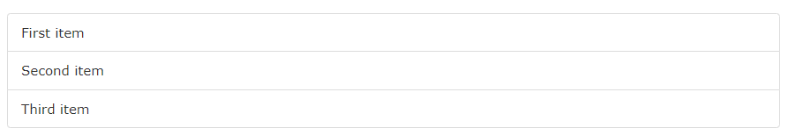
List group
The most basic list group is an unordered list with list items:
To create a basic list group, use an <ul> element with class .list-group, and <li> elements with class .list-group-item:
Example
<body>
<div class="container">
<h2>Basic List Group</h2>
<ul class="list-group">
<li class="list-group-item">First item</li>
<li class="list-group-item">Second item</li>
<li class="list-group-item">Third item</li>
</ul>
</div>
</body>

Slide 45
lists
Active items
Add .active to a .list-group-item to indicate the current active selection. class .list-group-item:
example
<ul class="list-group">
<li class="list-group-item active">Cras justo odio</li>
<li class="list-group-item">Dapibus ac facilisis in</li>
<li class="list-group-item">Morbi leo risus</li>
<li class="list-group-item">Porta ac consectetur ac</li>
<li class="list-group-item">Vestibulum at eros</li>
</ul>

Slide 46
lists
Disabled items
Add .disabled to a .list-group-item to make it appear disabled. Note that some elements with .disabled will also require custom JavaScript to fully disable their click events (e.g., links).
Example
<ul class="list-group">
<li class="list-group-item disabled">Cras justo odio</li>
<li class="list-group-item">Dapibus ac facilisis in</li>
<li class="list-group-item">Morbi leo risus</li>
<li class="list-group-item">Porta ac consectetur ac</li>
<li class="list-group-item">Vestibulum at eros</li>
</ul>

Slide 47
lists
Links and buttons
Use <a>s or <button>s to create actionable list group items with hover, disabled, and active states by adding .list-group-item-action. We separate these pseudo-classes to ensure list groups made of non-interactive elements (like <li>s or <div>s) don’t provide a click or tap affordance.
Example
<div class="list-group">
<a href="#" class="list-group-item list-group-item-action active"> Cras justo odio </a>
<a href="#" class="list-group-item list-group-item-action">Dapibus ac facilisis in</a>
<a href="#" class="list-group-item list-group-item-action">Morbi leo risus</a>
<a href="#" class="list-group-item list-group-item-action disabled">Vestibulum at eros</a>

Slide 48
lists
Flush
Add .list-group-flush to remove some borders and rounded corners to render list group items edge-to-edge in a parent container (e.g., cards).
example
<ul class="list-group list-group-flush">
<li class="list-group-item">Cras justo odio</li>
<li class="list-group-item">Dapibus ac facilisis in</li>
<li class="list-group-item">Morbi leo risus</li>
<li class="list-group-item">Porta ac consectetur ac</li>
<li class="list-group-item">Vestibulum at eros</li>
</ul>

Slide 49
lists
Contextual classes
Use contextual classes to style list items with a stateful background and color.
Example
<ul class=list-group>
<li class="list-group-item">Dapibus ac facilisis in</li>
<li class="list-group-item list-group-item-primary">This is a primary list group item</li>
<li class="list-group-item list-group-item-secondary">This is a secondary list group item</li></ul>

Slide 50
lists
With badges
Add badges to any list group item to show unread counts, activity, and more with the help of some utilities.
example
<div class="list-group">
<a class="list-group-item">
Cras justo odio
<span class="badge badge-primary">14</span>
</a>
</div>

Slide 51
forms
Bootstrap provides two types of form layouts:
Stacked (full-width) form
Inline form

Slide 52
forms
Form-control class
Use these classes to opt into their customized displays for a more consistent rendering across browsers and devices.
Input
Example for input tag with form-control class
<body>
<div class="container">
<div class= "w-50 mb-3">
<label> firstname</label>
<input type="text" class="form-control">
</div>
<div class="w-50">
<label> firstname</label>
<input type="text"></div></div>
</body>

Slide 53
forms
Textarea example
<div class="container w-50 mt-5">
<textarea row="5" cols="20" class="form-control"></textarea>
</div>
Dropdowns example
<div class="container">
<select class="form-control">
<option >1</option>
<option>2</option>
<option>1</option>
</select>
</div>

Slide 54
forms
Buttons example
<button type="submit">Submit</button>
<button type="submit" class="btn btn-primary">Submit</button>
Example for stacked form
<div class="form-group">
<label for="email">Email address:</label>
<input type="email" class="form-control" placeholder="Enter email" id="email">
</div>
<div class="form-group">
<label for="pwd">Password:</label>
<input type="password" class="form-control" placeholder="Enter password" id="pwd">
</div>

Slide 55
forms
<div class="form-group form-check">
<label class="form-check-label">
<input class="form-check-input" type="checkbox"> Remember me
</label>
</div>
<button type="submit" class="btn btn-primary">Submit</button>
</form>
</div>
</body>

Slide 56
forms
Bootstrap Inline Form
In an inline form, all of the elements are inline and left-aligned.
Note: This only applies to forms within viewports that are at least 576px wide. On screens smaller than 576px, it will stack horizontally.
Additional rule for an inline form:
Add class .form-inline to the <form> element

Slide 57
forms
<form class="form-inline" action="/action_page.php">
<label for="email">Email address:</label>
<input type="email" class="form-control" placeholder="Enter email" id="email">
<label for="pwd">Password:</label>
<input type="password" class="form-control" placeholder="Enter password" id="pwd">
<div class="form-check">
<label class="form-check-label">
<input class="form-check-input" type="checkbox"> Remember me
</label>
</div>
<button type="submit" class="btn btn-primary">Submit</button>
</form>

Slide 58
forms
Inline Form with Utilities
The inline form above feels "compressed", and will look much better with Bootstrap's spacing utilities. The following example adds a right margin (.mr-sm-2) to each input on all devices (small and up). And a margin bottom class (.mb-2) is used to style the input field when it breaks (goes from horizontal to vertical due to not enough space/width):

Slide 59
forms
<div class="container">
<form class="form-inline m-3" action="/action_page.php">
<label for="email" class="mr-sm-2">Email address:</label>
<input type="email" class="form-control mb-2 mr-sm-2" placeholder="Enter email" id="email">
<label for="pwd" class="mr-sm-2">Password:</label>
<input type="password" class="form-control mb-2 mr-sm-2" placeholder="Enter password" id="pwd">
<div class="form-check mb-2 mr-sm-2">
<label class="form-check-label">
<input class="form-check-input" type="checkbox"> Remember me
</label>
</div>
<button type="submit" class="btn btn-primary mb-2">Submit</button>
</form></div>

Slide 60
flex
Flexbox
The biggest difference between Bootstrap 3 and Bootstrap 4 is that Bootstrap 4 now uses flexbox, instead of floats, to handle the layout
Note: Flexbox is not supported in IE9 and earlier versions..
d-flex class
To create a flexbox container and to transform direct children into flex items, use the d-flex class:
example
<div class="container mt-3">
<h2>Flex</h2>
<p>To create a flexbox container and transform direct children into flex items, use the d-flex class:</p>
<div class="d-flex p-3 bg-secondary text-white">
<div class="p-2 bg-info">Flex item 1</div>
<div class="p-2 bg-warning">Flex item 2</div>
<div class="p-2 bg-primary">Flex item 3</div>
</div>
</div>

Slide 61
flex
To create an inline flexbox container, use the d-inline-flex class:
example
<div class="d-inline-flex p-3 bg-secondary text-white">
<div class="p-2 bg-info">Flex item 1</div>
<div class="p-2 bg-warning">Flex item 2</div>
<div class="p-2 bg-primary">Flex item 3</div>
</div>

Slide 62
flex
Horizontal Direction
Use .flex-row to display the flex items horizontally (side by side). This is default.
Use .flex-row-reverse to right-align the horizontal direction:
<div class="d-flex flex-row-reverse bg-secondary">
Vertical Direction
Use .flex-column to display the flex items vertically (on top of each other), or .flex-column-reverse to reverse the vertical direction:
<div class="d-flex flex-column">
<div class="d-flex flex-column-reverse">

Slide 63
flex
Auto Margins
Easily add auto margins to flex items with .mr-auto (push items to the right), or by using .ml-auto (push items to the left):
<div class="d-flex bg-secondary">
<div class="p-2 mr-auto bg-info">Flex item 1</div>
<div class="p-2 bg-warning">Flex item 2</div>
<div class="p-2 bg-primary">Flex item 3</div>
</div>

Slide 64
flex
Justify Content
Use the .justify-content-* classes to change the alignment of flex items. Valid classes are start (default), end, center, between or around:
<div class="d-flex justify-content-start">...</div>
<div class="d-flex justify-content-end">...</div>
<div class="d-flex justify-content-center">...</div> <div class="d-flex justify-content-between">...</div> <div class="d-flex justify-content-around">...</div>
Order
Change the visual order of a specific flex item(s) with the .order classes. Valid classes are from 0 to 12, where the lowest number has highest priority (order-1 is shown before order-2, etc..):
<div class="d-flex bg-secondary"> <div class="p-2 bg-info order-3">Flex item 1</div> <div class="p-2 bg-warning order-2">Flex item 2</div> <div class="p-2 bg-primary order-1">Flex item 3</div> </div>

Slide 65
flex
Wrap
Control how flex items wrap in a flex container with .flex-nowrap (default), .flex-wrap or .flex-wrap-reverse.
example
<div class="d-flex flex-wrap">..</div> <div class="d-flex flex-wrap-reverse">..</div> <div class="d-flex flex-nowrap">..</div>
Responsive Flex Classes
All flex classes comes with additional responsive classes, which makes it easy to set a specific flex class on a specific screen size.
The * symbol can be replaced with sm, md, lg or xl, which represents small, medium, large or xlarge screens.

Slide 66
flex
<div class="d-flex flex-sm-row-reverse bg-secondary mb-3">
<div class="p-2 bg-info">Flex item 1</div>
<div class="p-2 bg-warning">Flex item 2</div>
<div class="p-2 bg-primary">Flex item 3</div>
</div>
<div class="d-flex flex-md-column-reverse bg-secondary mb-3">
<div class="p-2 bg-info">Flex item 1</div>
<div class="p-2 bg-warning">Flex item 2</div>
<div class="p-2 bg-primary">Flex item 3</div>
</div>
.

Slide 67
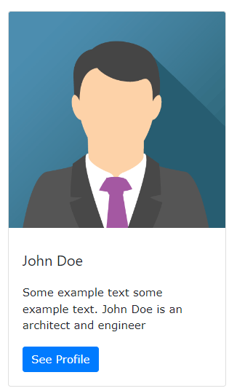
cards
Cards
A card in Bootstrap 4 is a bordered box with some padding around its content. It includes options for headers, footers, content, colors, etc.

Slide 68
cards
Basic Card
A basic card is created with the .card class, and content inside the card has a .card-body class:
<div class="container">
<h2>Basic Card</h2>
<div class="card">
<div class="card-body">Basic card</div>
</div>
</div>

Slide 69
cards
Header and Footer
The .card-header class adds a heading to the card and the .card-footer class adds a footer to the card:
<div class="container">
<h2>Card Header and Footer</h2>
<div class="card">
<div class="card-header">Header</div>
<div class="card-body">Content</div>
<div class="card-footer">Footer</div>
</div>
</div>

Slide 70
cards
Contextual Cards
To add a background color the card, use contextual classes (.bg-primary, .bg-success, .bg-info, .bg-warning, .bg-danger, .bg-secondary, .bg-dark and .bg-light.)
<div class="container">
<h2>Card Header and Footer</h2>
<div class="card bg-primary">
<div class="card-header">Header</div>
<div class="card-body">Content</div>
<div class="card-footer">Footer</div>
</div>
</div>

Slide 71
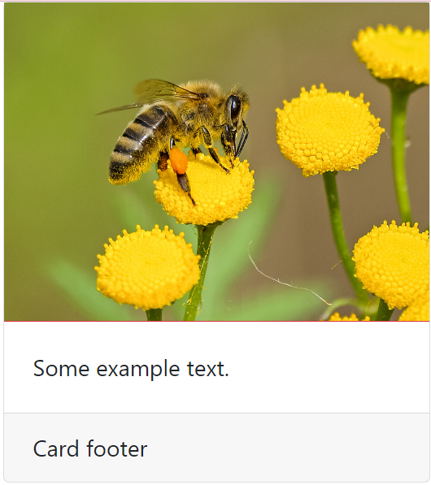
cards
Card Images
<div class="container">
<div class="card" style=width:300px>
<img src="honey.jpg" class="border-bottom border-danger“>
<div class="card-body">Some example text. </div>
<div class="card-footer">Card footer</div>
</div>
</div>

Slide 72
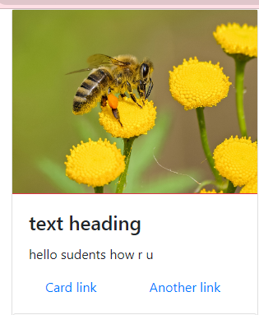
cards
Use .card-title to add card titles to any heading element. The .card-text class is used to remove bottom margins for a <p> element if it is the last child (or the only one) inside .card-body. The .card-link class adds a blue color to any link, and a hover effect
<div class="card" style=width:300px>
<img src="honey.jpg" class="border-bottom border-danger">
<div class="card-body">
<h4 class="card-title"> text heading</h4>
<p class="card-text"> hello sudents how r u </p>
<a href="#" class="card-link">Card link</a>
<a href="#" class="card-link">Another link</a>
</div>

Slide 73
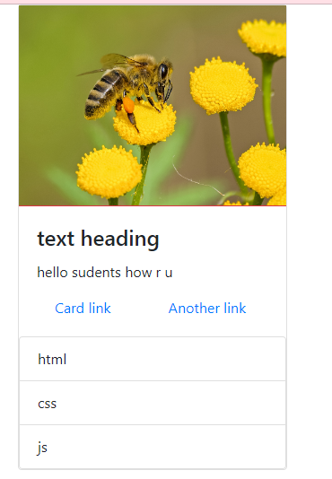
cards
Adding list-group after card-body
<div class="card" style=width:300px>
<img src="honey.jpg" class="border-bottom border-danger">
<div class="card-body">
<h4 class="card-title"> text heading</h4>
<p class="card-text"> hello sudents how r u </p>
<a href="#" class="card-link">Card link</a>
<a href="#" class="card-link">Another link</a>
</div>
<ul class="list-group">
<li href="#" class="list-group-item">html</li>
<li href="#" class="list-group-item">css</li>
<li href="#" class="list-group-item">js</li></ul></div>

Slide 74
cards
Adding list-group after card-body
<div class="card" style=width:300px>
<img src="honey.jpg" class="border-bottom border-danger">
<div class="card-body">
<h4 class="card-title"> text heading</h4>
<p class="card-text"> hello sudents how r u </p>
<a href="#" class="card-link">Card link</a>
<a href="#" class="card-link">Another link</a>
</div>
<ul class="list-group">
<li href="#" class="list-group-item">html</li>
<li href="#" class="list-group-item">css</li>
<li href="#" class="list-group-item">js</li></ul></div>

Slide 75
cards
Card deck
The .card-deck class creates a grid of cards that are of equal height and width. The layout will automatically adjust as you insert more cards.
Note: The cards are displayed vertically on small screens (less than 576px):
<div class="card-deck">
<div class="card bg-primary">
<div class="card-body text-center">
<p class="card-text">Some text inside the first card</p>
</div>
</div>
<div class="card bg-warning">
<div class="card-body text-center">
<p class="card-text">Some text inside the second card</p>
</div>

Slide 76
cards
</div>
<div class="card bg-success">
<div class="card-body text-center">
<p class="card-text">Some text inside the third card</p>
</div>
</div>
<div class="card bg-danger">
<div class="card-body text-center">
<p class="card-text">Some text inside the fourth card</p>
</div>
</div>
</div>

Slide 77
cards
Card Group
The .card-group class is similar to .card-deck. The only difference is that the .card-group class removes left and right margins between each card.
Note: The cards are displayed vertically on small screens (less than 576px), WITH top and bottom margin:
<div class="card-group">
<div class="card bg-primary">
<div class="card-body text-center">
<p class="card-text">Some text inside the first card</p>
</div>
</div>
<div class="card bg-warning">
<div class="card-body text-center">
<p class="card-text">Some text inside the second card</p>
</div>

Slide 78
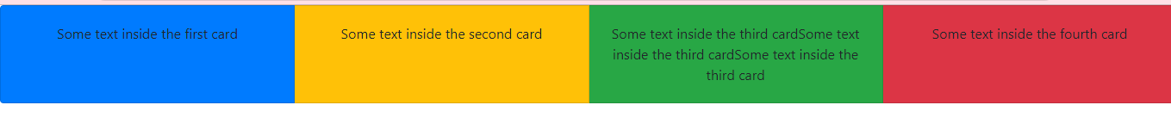
cards
</div>
<div class="card bg-success">
<div class="card-body text-center">
<p class="card-text">Some text inside the third card</p>
</div>
</div>
<div class="card bg-danger">
<div class="card-body text-center">
<p class="card-text">Some text inside the fourth card</p>
</div>
</div>
</div>

Slide 79
cards
Card Columns
The .card-columns class creates a masonry-like grid of cards (like pinterest). The layout will automatically adjust as you insert more cards.
Note: The cards are displayed vertically on small screens (less than 576px):
<div class="card-columns">
<div class="card bg-primary">
<div class="card-body text-center">
<p class="card-text">Some text inside the first cardSome text inside the first cardSome text inside the first card</p>
</div>
</div>

Slide 80
cards
<div class="card bg-warning">
<div class="card-body text-center">
<p class="card-text">Some text inside the second cardSome text inside the second card</p>
</div>
</div>
<div class="card bg-success">
<div class="card-body text-center">
<p class="card-text">Some text inside the third card</p>
</div>
</div>
<div class="card bg-danger">
<div class="card-body text-center">
<p class="card-text">Some text inside the fourth card</p>

Slide 81
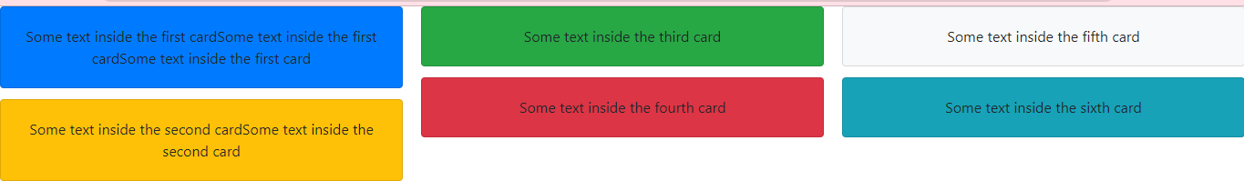
cards
</div>
</div>
<div class="card bg-light">
<div class="card-body text-center">
<p class="card-text">Some text inside the fifth card</p>
</div>
</div>
<div class="card bg-info">
<div class="card-body text-center">
<p class="card-text">Some text inside the sixth card</p>
</div>
</div>
</div>

Slide 82
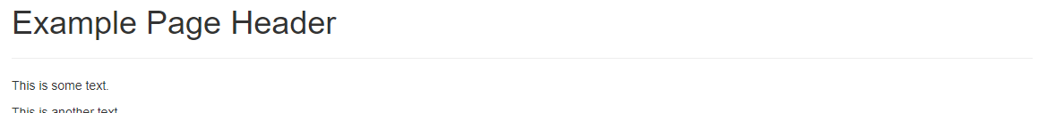
Page header
Creating a Page Header
A page header is like a section divider.
The .page-header class adds a horizontal line under the heading (+ adds some extra space around the element):
<div class="container">
<div class="page-header">
<h1>Example Page Header</h1>
</div>
<p>This is some text.</p>
<p>This is another text.</p>
</div>

Slide 83

Bootstrap Carousel
The Carousel is a slideshow for cycling through elements.

Slide 84
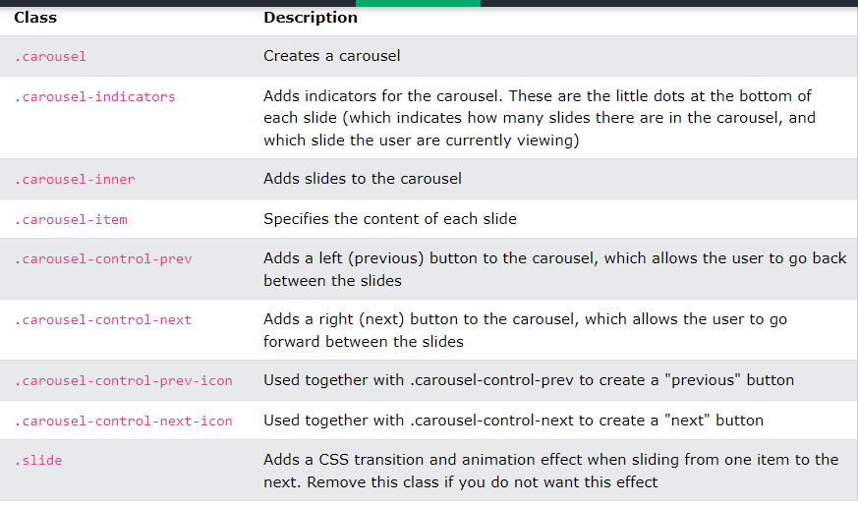
Bootstrap Carousel

Slide 85
Bootstrap Carousel
<!-- The slideshow -->
<div id=ale class="carousel slide" data-ride="carousel">
<div class="carousel-inner">
<div class="carousel-item">
<img src="gandhi.jpg" alt="hi" width="1000" height="500">
</div>
<div class="carousel-item active">
<img src="x.jpg" alt="hi" width="1000" height="500">
</div>
<div class="carousel-item">
<img src="honey.jpg" alt="hi" width="1000" height="500">
</div>
</div>

Slide 86
Bootstrap Carousel
<!-- Left and right controls -->
<a class="carousel-control-prev" href="#ale" data-slide="prev">
<span class="carousel-control-prev-icon"></span>
</a>
<a class="carousel-control-next" href="#ale" data-slide="next">
<span class="carousel-control-next-icon"></span>
</a>

Slide 87
Bootstrap Carousel
<!-- Indicators --> <ul class="carousel-indicators">
<li data-target="#ale" data-slide-to="0" class="active"></li>
<li data-target="#ale" data-slide-to="1"></li>
<li data-target="#ale" data-slide-to="2"></li>
</ul>

Slide 88
Bootstrap Carousel
How to use all in file
<body>
<div id=ale class="carousel slide" data-ride="carousel">
<!-- Indicators -->
<ul class="carousel-indicators">
<li data-target="#ale" data-slide-to="0" class="active"></li>
<li data-target="#ale" data-slide-to="1"></li>
<li data-target="#ale" data-slide-to="2"></li>
</ul>
<div class="carousel-inner">
<div class="carousel-item active">
<img src="gandhi.jpg" alt="hi" >
</div>

Slide 89
Bootstrap Carousel
<div class="carousel-item ">
<img src="x.jpg" alt="hi" ">
</div>
<div class="carousel-item">
<img src="honey.jpg" alt="hi" >
</div>
<a class="carousel-control-prev" href="#ale" data-slide="prev">
<span class="carousel-control-prev-icon"></span>
</a>
<a class="carousel-control-next" href="#ale" data-slide="next">
<span class="carousel-control-next-icon"></span>
</a>
</div>
</body>

Slide 90
Bootstrap Carousel
Include this code in head tag
<style>
.carousel-inner img {
width: 100%;
height: auto;
}

Slide 91
modal
The Modal component is a dialog box/popup window that is displayed on top of the current page:
<body>
<div class="text-center">
<button class="btn btn-primary" data-toggle="modal" data-target="#click">submit</button>
</div>
<div class="modal" id="click">
<div class="modal-header"> header</div>
<div class="modal-body">
<div class="form-group">
<label>email</label>

Slide 92
modal
<input type="email" class="form-control">
</div>
<div class="form-group">
<label>password</label>
<input type="password" class="form-control">
</div>
</div>
<div class="modal-footer">
<button class="btn btn-primary">success</button>
<button class="btn btn-primary">close</button>
</div>
</div>
</body>

Slide 93
modal
when u click on submit button if we want to get customized window u need to add 2 more classes in modal div
<div class="modal" id="click">
<div class="modal-dialog">
<div class="modal-content">

Slide 94
modal
If u want to close the window when u click on close button we have to add 1 more attribute in button tag
<button class="btn btn-primary" data-dismiss="modal">close</button>
If u want to get × symbol in header and If u want to close the window when u click on × add 1 more button tag in header
<button class="btn btn-primary" data-dismiss="modal"> × </button>

Slide 95
modal
Final code
<body>
<div class="text-center">
<button class="btn btn-primary" data-toggle="modal" data-target="#click">submit</button>
</div>
<div class="modal" id="click">
<div class="modal-dialog">
<div class="modal-content">
<div class="modal-header">
<h3 class= "w-100 text-center"> login form</h3>
<button class="btn btn-primary" data-dismiss="modal">×</button>
</div>

Slide 96
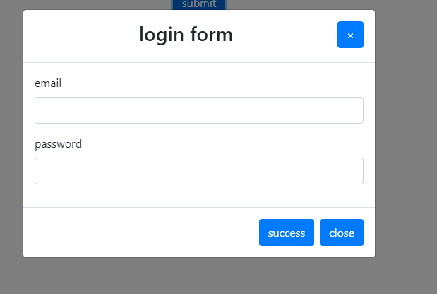
modal
<div class="modal-body">
<div class="form-group">
<label>email</label>
<input type="email" class="form-control">
</div>
<div class="form-group">
<label>password</label>
<input type="password" class="form-control">
</div>
</div>
<div class="modal-footer">
<button class="btn btn-primary">success</button>
<button class="btn btn-primary" data-dismiss="modal">close</button>
</div>
</div>
</div>
</div>
</body>

Slide 97
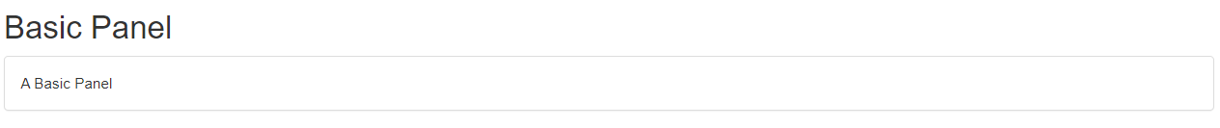
panels
A panel in bootstrap is a bordered box with some padding around its content:
<div class="panel panel-default"> <div class="panel-body">A Basic Panel</div> </div>
Note: panels ae dropped in bootstrap4

Slide 98
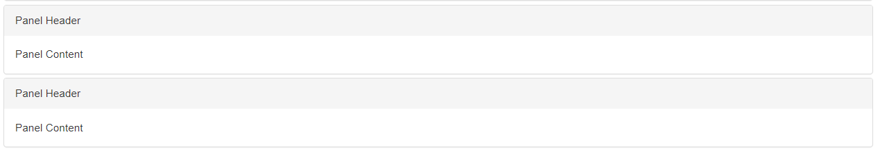
panels
Panel-heading and Panel-footer
The .panel-heading class adds a heading to the panel:
The .panel-footer class adds a footer to the panel:
Panel Group
To group many panels together, wrap a <div> with class .panel-group around them.
The .panel-group class clears the bottom-margin of each panel:

Slide 99
panels
<div class="container">
<h2>Panel Group</h2>
<p>The panel-group class clears the bottom-margin. Try to remove the class and see what happens.</p>
<div class="panel-group">
<div class="panel panel-default">
<div class="panel-heading">Panel Header</div>
<div class="panel-body">Panel Content</div>
</div>
<div class="panel panel-default">
<div class="panel-heading">Panel Header</div>
<div class="panel-body">Panel Content</div>
</div></div></div>

Slide 100
panels
Panels with Contextual Classes
To color the panel, use contextual classes (.panel-default, .panel-primary, .panel-success, .panel-info, .panel-warning, or .panel-danger):
example
<div class="panel panel-primary">
<div class="panel-heading">Panel with panel-primary class</div>
<div class="panel-body">Panel Content</div>
</div>

Slide 101
Nav bar
Navigation Bars
A navigation bar is a navigation header that is placed at the top of the page:
A standard navigation bar is created with the .navbar class,
To add links inside the navbar, use a <ul> element with class="navbar-nav". Then add <li> elements with a .nav-item class followed by an <a> element with a .nav-link class:

Slide 102
Nav bar
<nav class="navbar">
<!-- Links -->
<ul class="navbar-nav">
<li class="nav-item">
<a class="nav-link" href="#">Link 1</a>
</li>
<li class="nav-item">
<a class="nav-link" href="#">Link 2</a>
</li>
<li class="nav-item">
<a class="nav-link" href="#">Link 3</a>
</li>
</ul>
</nav>
</body>

Slide 103
Nav bar
Responsive Navbar
With Bootstrap, a navigation bar can extend or collapse, depending on the screen size. A standard navigation bar is created with the .navbar class, followed by a responsive collapsing class: .navbar-expand-xl|lg|md|sm
<body>
<nav class="navbar navbar-expand-sm bg-light">
<!-- Links -->
<ul class="navbar-nav">
<li class="nav-item">
<a class="nav-link" href="#">Link 1</a>
</li>
<li class="nav-item">
<a class="nav-link" href="#">Link 2</a>
</li>
<li class="nav-item">
<a class="nav-link" href="#">Link 3</a>
</li>
</ul>
</nav>
</body>

Slide 104
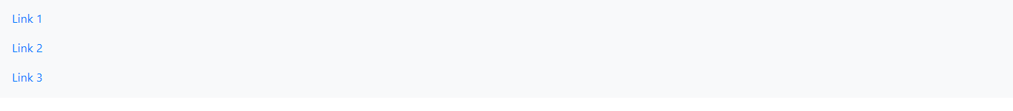
Nav bar
Vertical Navbar
Remove the .navbar-expand-xl|lg|md|sm class to create a vertical navigation bar:
<nav class="navbar bg-light">
Centered Navbar
Add the .justify-content-center class to center the navigation bar.
The following example will center the navigation bar on medium, large and extra large screens. On small screens it will be displayed vertically (because of the .navbar-expand-sm class):
<nav class="navbar navbar-expand-sm bg-light justify-content-center">

Slide 105
Nav bar
Colored Navbar
Use any of the .bg-color classes to change the background color of the navbar (.bg-primary, .bg-success, .bg-info, .bg-warning, .bg-danger, .bg-secondary, .bg-dark and .bg-light)
Tip: Add a white text color to all links in the navbar with the .navbar-dark class, or use the .navbar-light class to add a black text color.
<nav class="navbar navbar-expand-sm bg-light navbar-light">

Slide 106
Nav bar
Brand / Logo
The .navbar-brand class is used to highlight the brand/logo/project name of your page:
<nav class="navbar navbar-expand-sm bg-light navbar-light">
<!-- Brand/logo -->
<a class="navbar-brand" href="#">
<img src="honey.jpg" width="40px"></a>
</a>
Collapsing The Navigation Bar
Very often, especially on small screens, you want to hide the navigation links and replace them with a button that should reveal them when clicked on.
To create a collapsible navigation bar, use a button with class="navbar-toggler", data-toggle="collapse" and data-target="#thetarget". Then wrap the navbar content (links, etc) inside a div element with class="collapse navbar-collapse", followed by an id that matches the data-target of the button: "thetarget".

Slide 107
Nav bar
<nav class="navbar navbar-expand-md bg-dark navbar-dark"> <!-- Brand --> <a class="navbar-brand" href="#">Navbar</a> <!-- Toggler/collapsible Button --> <button class="navbar-toggler" type="button" data-toggle="collapse" data-target="#collapsibleNavbar"> <span class="navbar-toggler-icon"></span> </button>

Slide 108
Nav bar
<!-- Navbar links --> <div class="collapse navbar-collapse" id="collapsibleNavbar"> <ul class="navbar-nav"> <li class="nav-item"> <a class="nav-link" href="#">Link</a> </li> <li class="nav-item"> <a class="nav-link" href="#">Link</a> </li> <li class="nav-item"> <a class="nav-link" href="#">Link</a> </li> </ul> </div> </nav>

Slide 109
Nav bar dropdown
<li class="nav-item dropdown"> <a class="nav-link dropdown-toggle" href="#" data-toggle="dropdown"> Dropdown link </a> <div class="dropdown-menu"> <a class="dropdown-item" href="#">Link 1</a> <a class="dropdown-item" href="#">Link 2</a> <a class="dropdown-item" href="#">Link 3</a> </div> </li>

Slide 110
Nav bar dropdown
<body>
<nav class="navbar bg-dark navbar-dark">
<!-- Brand -->
<a class="navbar-brand" href="#">Navbar</a>
<!-- Toggler/collapsibe Button -->
<button class="navbar-toggler ml-auto" type="button" data-toggle="collapse" data-target="#collapsibleNavbar">
<span class="navbar-toggler-icon"></span>
</button>
<!-- Navbar links -->
<div class="collapse navbar-collapse" id="collapsibleNavbar">
<ul class="navbar-nav ml-auto">

Slide 111
Nav bar dropdown
<li class="nav-item">
<a class="nav-link" href="#">Link</a>
</li>
<li class="nav-item">
<a class="nav-link" href="#">Link</a>
</li>
<li class="nav-item">
<a class="nav-link" href="#">Link</a>
</li>
<!-- Dropdown -->
<li class="nav-item dropdown">
<a class="nav-link dropdown-toggle" href="#" data-toggle="dropdown">

Slide 112
Nav bar dropdown
Dropdown link
</a>
<div class="dropdown-menu">
<a class="dropdown-item" href="#">Link 1</a>
<a class="dropdown-item" href="#">Link 2</a>
<a class="dropdown-item" href="#">Link 3</a>
</div>
</li>
</ul>
</div>
<ul>
</nav>

Slide 113
Alerts
Bootstrap Alerts:
Alert boxes are used quite often to stand out the information that requires immediate attention of the end users such as warning, error or confirmation messages.
You can create a simple Bootstrap warning alert message box by adding the contextual. class .alert-warning to the .alert base class
Data attributes provides a simple and easy way to add close functionality to the alert boxes. Just add the data-dismiss="alert" to the close button and it will automatically enable the dismissal of the containing alert message box.
Also, add the class .alert-dismissible to the .alert element for proper positioning of the .close button.
Bootstrap Buttons:
*) Buttons are the integral part of a website and application. They are used for various purposes like, submit or reset an HTML form, performing interactive actions such as showing or hiding something on a web page on click of the button, redirecting user to another page, and so on. Bootstrap provides a quick and easy way to create and customize the buttons.

Slide 114
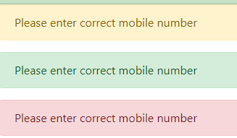
Alerts
Bootstrap provides an easy way to create predefined alert messages:
Success! This alert box indicates a successful or positive action.
Info! This alert box indicates a neutral informative change or action.
Warning! This alert box indicates a warning that might need attention.
Danger! This alert box indicates a dangerous or potentially negative action.
Alerts are created with the .alert class, followed by one of the four contextual classes .alert-success, .alert-info, .alert-warning or .alert-danger:
<body>
<div class="alert alert-warning">
Please enter correct mobile number
</div>
<div class="alert alert-success">
Please enter correct mobile number
</div>
<div class="alert alert-danger">
Please enter correct mobile number
</div></body>

Slide 115
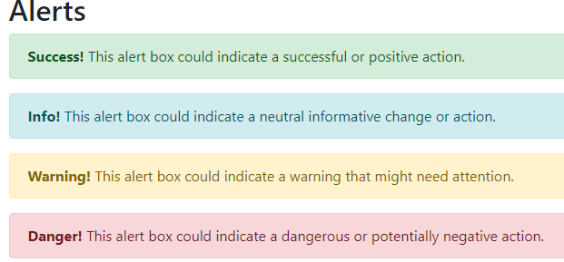
Alerts
<div class="container">
<h2> Alerts </h2>
<div class="alert alert-success">
<strong>Success!</strong> This alert box could indicate a successful or positive action.</div>
<div class="alert alert-info">
<strong>Info!</strong> This alert box could indicate a neutral informative change or action.</div>
<div class="alert alert-warning">
<strong>Warning!</strong> This alert box could indicate a warning that might need attention.</div>
<div class="alert alert-danger">
<strong>Danger!</strong> This alert box could indicate a dangerous or potentially negative action.</div></div>

Slide 116
Alerts
Alert Links
Add the alert-link class to any links inside the alert box to create "matching colored links":
Success! You should read this message.
Info! You should read this message.
Warning! You should read this message.
Danger! You should read this message.

Slide 117
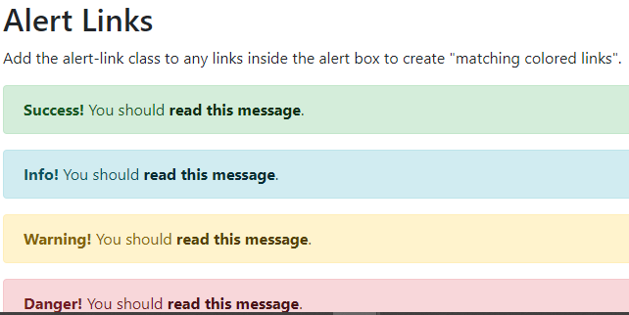
<div class="container">
<h2>Alert Links</h2>
<p>Add the alert-link class to any links inside the alert box to create "matching colored links".</p>
<div class="alert alert-success">
<strong>Success!</strong> You should <a href="#" class="alert-link">read this message</a>.</div>
<div class="alert alert-info">
<strong>Info!</strong> You should <a href="#" class="alert-link">read this message</a>.</div>
<div class="alert alert-warning">
<strong>Warning!</strong> You should <a href="#" class="alert-link">read this message</a>.</div>
<div class="alert alert-danger">
<strong>Danger!</strong> You should <a href="#" class="alert-link">read this message</a>.</div></div>

Slide 118
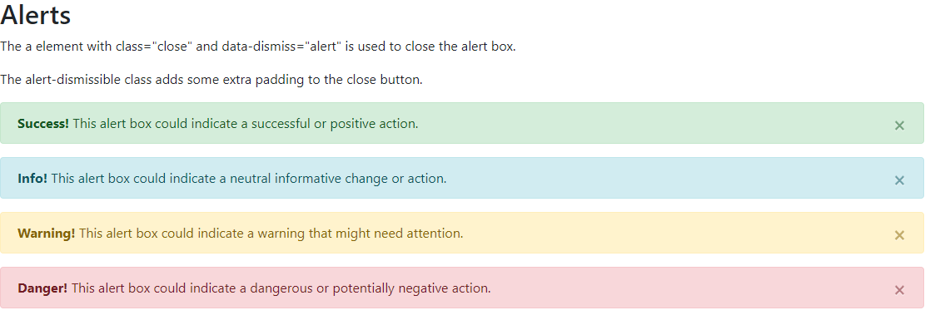
Alerts
Closing Alerts:
Click on the "x" symbol to the right to close me.
To close the alert message, add a .alert-dismissible class to the alert container.
Then add class="close" and data-dismiss="alert" to a link or a button element (when you click on this the alert box will disappear).

Slide 119
Alerts
<div class="container">
<h2>Alerts</h2>
<p>The a element with class="close" and data-dismiss="alert" is used to close the alert box.</p>
<p>The alert-dismissible class adds some extra padding to the close button.</p>
<div class="alert alert-success alert-dismissible">
<a href="#" class="close" data-dismiss="alert" aria-label="close">&times;</a>
<strong>Success!</strong> This alert box could indicate a successful or positive action.</div>
<div class="alert alert-info alert-dismissible">
<a href="#" class="close" data-dismiss="alert" aria-label="close">&times;</a>
<strong>Info!</strong> This alert box could indicate a neutral informative change or action.</div>
<div class="alert alert-warning alert-dismissible">
<a href="#" class="close" data-dismiss="alert" aria-label="close">&times;</a>
<strong>Warning!</strong> This alert box could indicate a warning that might need attention.</div>
<div class="alert alert-danger alert-dismissible">
<a href="#" class="close" data-dismiss="alert" aria-label="close">&times;</a>
<strong>Danger!</strong> This alert box could indicate a dangerous or potentially negative action.</div></div>

Slide 120
Buttons
Bootstrap Buttons:
*) Buttons are the integral part of a website and application. They are used for various purposes like, submit or reset an HTML form, performing interactive actions such as showing or hiding something on a web page on click of the button, redirecting user to another page, and so on. Bootstrap provides a quick and easy way to create and customize the buttons.
*) Button styles can be applied to any element. However, it is applied normally to the <a>, <input>, and <button> elements for the best rendering.
*) You can also create outline buttons by replacing the button modifier classes
*) Bootstrap gives you option further to scaling a button up or down. You can make buttons larger or smaller through adding an extra class .btn-lg or .btn-sm
*) You can also create block level buttons (buttons that covers the full width of the parent elements) by adding an extra class .btn-block to the buttons
*) Sometimes we need to disable a button for certain reasons, for example, a user in case is not eligible to perform this particular action, or we want to ensure that user should performed all other required actions before proceed to this particular action. *) With Bootstrap you can easily include spinner icon in a button to indicate the loading state in your application.

Slide 121
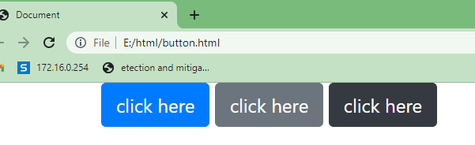
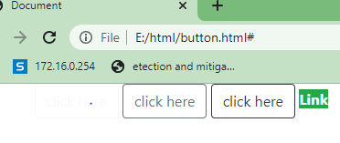
Buttons
<body>
<div class="container">
<button class="btn btn-primary">click here</button>
<button class="btn btn-secondary">click here</button>
<button class="btn btn-dark">click here</button>
</div>
</body>
<body>
<div class="container">
<button class="btn btn-outline-light">click here</button>
<button class="btn btn-outline-secondary">click here</button>
<button class="btn btn-outline-dark">click here</button>
<a href="#" class="alert-link btn-success">Link</a>
</div>
</body>

Slide 122
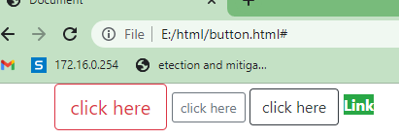
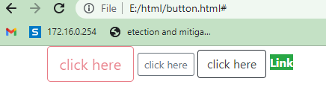
Buttons
<body>
<div class="container">
<button class="btn btn-outline-danger btn-lg">click here</button>
<button class="btn btn-outline-secondary btn-sm">click here</button>
<button class="btn btn-outline-dark">click here</button>
<a href="#" class="alert-link btn-success">Link</a>
</div>
</body>
<body>
<div class="container">
<button class="btn btn-outline-danger btn-lg" disabled="false">click here</button>
<button class="btn btn-outline-secondary btn-sm">click here</button>
<button class="btn btn-outline-dark">click here</button>
<a href="#" class="alert-link btn-success">Link</a>
</div>
</body>

Slide 123
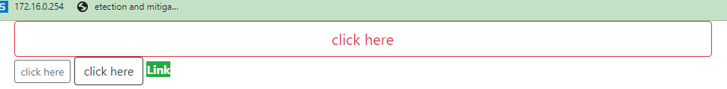
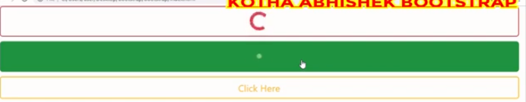
<div class="container">
<button class="btn btn-outline-danger btn-lg btn-block" >click here</button>
<button class="btn btn-outline-secondary btn-sm">click here</button>
<button class="btn btn-outline-dark">click here</button>
<a href="#" class="alert-link btn-success">Link</a>
</div>
<body>
<div class="container">
<button class="btn btn-outline-danger btn-lg btn-block" ><span class="spinner-grow"></span>click here</button>
<button class="btn btn-outline-secondary btn-lg btn-block"><span class="spinner-border"></span>click here</button>
<button class="btn btn-outline-dark">click here</button>
<a href="#" class="alert-link btn-success">Link</a>
</div></body>

Slide 124
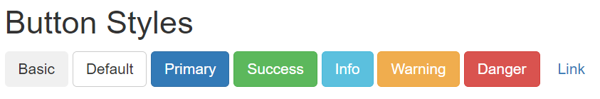
Buttons
<body>
<div class="container">
<h2>Button Styles</h2>
<button type="button" class="btn">Basic</button>
<button type="button" class="btn btn-default">Default</button>
<button type="button" class="btn btn-primary">Primary</button>
<button type="button" class="btn btn-success">Success</button>
<button type="button" class="btn btn-info">Info</button>
<button type="button" class="btn btn-warning">Warning</button>
<button type="button" class="btn btn-danger">Danger</button>
<button type="button" class="btn btn-link">Link</button>
</div> </body>
To achieve the button styles above, Bootstrap has the following classes:
.btn
.btn-default
.btn-primary
.btn-success
.btn-info
.btn-warning
.btn-danger
.btn-link

Slide 125
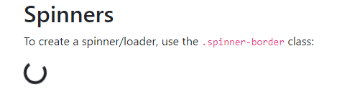
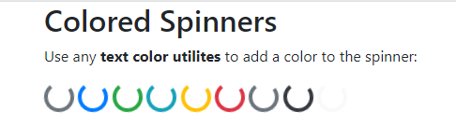
Spinners
<div class="container">
<h2>Spinners</h2>
<p>To create a spinner/loader, use the <code>.spinner-border</code> class:</p>
<div class="spinner-border"></div>
</div>
<div class="container">
<h2>Colored Spinners</h2>
<p>Use any <strong>text color utilites</strong> to add a color to the spinner:</p>
<div class="spinner-border text-muted"></div>
<div class="spinner-border text-primary"></div>
<div class="spinner-border text-success"></div>
<div class="spinner-border text-info"></div>
<div class="spinner-border text-warning"></div>
<div class="spinner-border text-danger"></div>
<div class="spinner-border text-secondary"></div>
<div class="spinner-border text-dark"></div>
<div class="spinner-border text-light"></div>
</div>

Slide 126
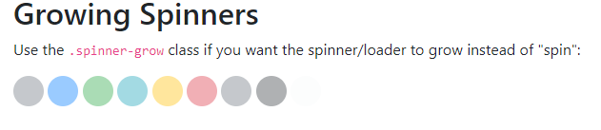
Spinners
<h2>Growing Spinners</h2>
<p>Use the <code>.spinner-grow</code> class if you want the spinner/loader to grow instead of "spin":</p>
<div class="spinner-grow text-muted"></div>
<div class="spinner-grow text-primary"></div>
<div class="spinner-grow text-success"></div>
<div class="spinner-grow text-info"></div>
<div class="spinner-grow text-warning"></div>
<div class="spinner-grow text-danger"></div>
<div class="spinner-grow text-secondary"></div>
<div class="spinner-grow text-dark"></div>
<div class="spinner-grow text-light"></div>
</div>

Slide 127
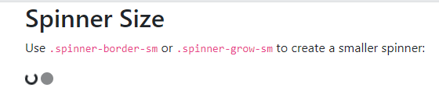
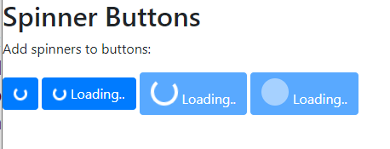
Spinners
<div class="container">
<h2>Spinner Size</h2>
<p>Use <code>.spinner-border-sm</code> or <code>.spinner-grow-sm</code> to create a smaller spinner:</p>
<div class="spinner-border spinner-border-sm"></div>
<div class="spinner-grow spinner-grow-sm"></div>
</div>
Spinner Buttons
<button class="btn btn-primary"> <span class="spinner-border spinner-border-sm"></span> </button> <button class="btn btn-primary"> cc</span> Loading.. </button> <button class="btn btn-primary" disabled> <span class="spinner-border "></span>Loading.. </button> <button class="btn btn-primary" disabled> <span class="spinner-grow "></span>Loading.. </button>

Slide 128
Buttons
class=“btn”
class=“btn btn-default”
class=“ btn btn-primary”
class=“btn btn-success”
class=“btn btn-info”
class=“btn btn-warning”
class=“btn btn-danger”
class=“btn btn-link”
class="btn btn-primary btn-lg"
class="btn btn-primary btn-sm“
class="btn btn-primary btn-xs“
class="btn btn-primary active“
class="btn btn-primary disabled“
class = "btn btn-primary btn-block"
<span class="spinner-border spinner-border-sm">
<button class="btn btn-primary" disabled> <span class="spinner-grow "></span>Loading.. </button>

Slide 129

pagination
If you have a web site with lots of pages, you may wish to add some sort of pagination to each page.
To create a basic pagination, add the .pagination class to an <ul> element. Then add the .page-item to each <li> element and a .page-link class to each link inside <li>:
<body>
<ul class="pagination">
<li class="page-item"><a class="page-link" href="#">Previous</a></li>
<li class="page-item"><a class="page-link" href="#">1</a></li>
<li class="page-item"><a class="page-link" href="#">2</a></li>
<li class="page-item"><a class="page-link" href="#">3</a></li>
<li class="page-item"><a class="page-link" href="#">Next</a></li>
</ul>
</body>

Slide 130

pagination
Active State
The .active class is used to "highlight" the current page:
example
<ul class="pagination"> <li class="page-item"><a class="page-link" href="#">Previous</a></li> <li class="page-item"><a class="page-link" href="#">1</a></li> <li class="page-item active"><a class="page-link" href="#">2</a></li> <li class="page-item"><a class="page-link" href="#">3</a></li> <li class="page-item"><a class="page-link" href="#">Next</a></li> </ul>

Slide 131

pagination
Disabled State
The .disabled class is used for un-clickable links:
<ul class="pagination"> <li class="page-item disabled"><a class="page-link" href="#">Previous</a></li> <li class="page-item"><a class="page-link" href="#">1</a></li> <li class="page-item"><a class="page-link" href="#">2</a></li> <li class="page-item"><a class="page-link" href="#">3</a></li> <li class="page-item"><a class="page-link" href="#">Next</a></li> </ul>

Slide 132
pagination
Pagination Sizing
Pagination blocks can also be sized to a larger or a smaller size:
Add class .pagination-lg for larger blocks or .pagination-sm for smaller blocks: <ul class="pagination pagination-lg"> <li class="page-item"><a class="page-link" href="#">Previous</a></li> <li class="page-item"><a class="page-link" href="#">1</a></li> <li class="page-item"><a class="page-link" href="#">2</a></li> <li class="page-item"><a class="page-link" href="#">3</a></li> <li class="page-item"><a class="page-link" href="#">Next</a></li> </ul>

Slide 133
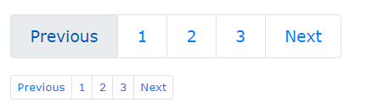
pagination
<ul class="pagination pagination-sm"> <li class="page-item"><a class="page-link" href="#">Previous</a></li> <li class="page-item"><a class="page-link" href="#">1</a></li> <li class="page-item"><a class="page-link" href="#">2</a></li> <li class="page-item"><a class="page-link" href="#">3</a></li> <li class="page-item"><a class="page-link" href="#">Next</a></li> </ul>

Slide 134
pagination
Pagination Alignment
Use utility classes to change the alignment of the pagination
<ul class="pagination justify-content-center" style="margin:20px 0">
<li class="page-item">
<a class="page-link" href="#">
Previous</a></li>
<li class="page-item">
<a class="page-link"href="#">1</a>
</li></ul>

Slide 135
pagination
<ul class="pagination justify-content-end" style="margin:20px 0">
<li class="page-item"></li>
<a class="page-link" href="#">2</a>
</li>
<li class="page-item">
<a class="page-link" href="#">3</a>
</li>
<li class="page-item">
<a class="page-link"href="#">Next</a></li>
</ul>

Slide 136

pagination
Breadcrumbs
Another form for pagination, is breadcrumbs:
<body>
<ul class="breadcrumb">
<li class="breadcrumb-item"><a href="#">Photos</a></li>
<li class="breadcrumb-item"><a href="#">Summer 2017</a></li>
<li class="breadcrumb-item"><a href="#">Italy</a></li>
<li class="breadcrumb-item active">Rome</li>
</ul>
</body>

